Slide 1
Design Patterns
GoF Observer
“The critical design tool for software development
is a mind well educated in design principles”

Slide 2
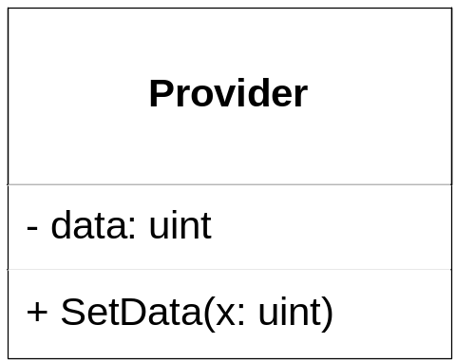
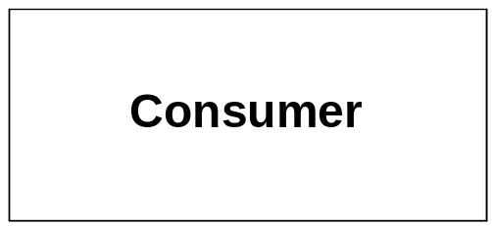
Decoupling the general “data-update” problem
Let’s take a look at the general “data-update” problem.
Provider contains data which changes every now and them
Consumer uses data and would like to do some update based on changes in data
How can we realize this coupling?

Slide 3
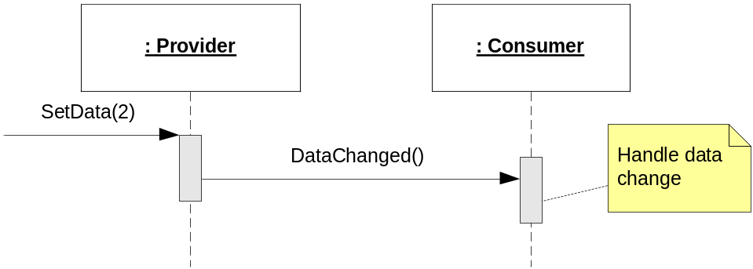
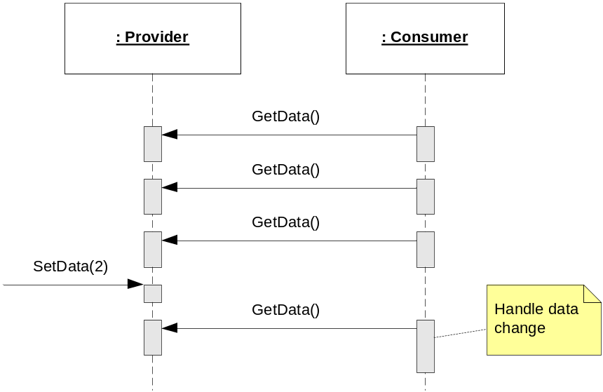
Decoupling the general “data-update” problem
Discuss pros and cons of these typical solutions
Provider notifies Consumer
when data changes
Consumer polls Provider

Slide 4
GoF Observer to the rescue!
We need some mechanism that…

Slide 5
GoF Observer to the rescue!
We need some mechanism that…
  allows Consumers to be added to the Provider without changing the Provider (i.e. adhere to OCP)

Slide 6
GoF Observer to the rescue!
We need some mechanism that…
  allows Consumers to be added to the Provider without changing the Provider (i.e. adhere to OCP)
  allows Provider to inform Consumers of data changes (i.e. promotes low coupling)

Slide 7
GoF Observer to the rescue!
We need some mechanism that…
  allows Consumers to be added to the Provider without changing the Provider (i.e. adhere to OCP)
  allows Provider to inform Consumers of data changes (i.e. promotes low coupling)
  allows many Consumers to be informed on updates of same data

Slide 8

GoF Observer to the rescue!
We need some mechanism that…
  allows Consumers to be added to the Provider without changing the Provider (i.e. adhere to OCP)
  allows Provider to inform Consumers of data changes (i.e. promotes low coupling)
  allows many Consumers to be informed on updates of same data
We need….GoF Observer!
Define a one-to-many dependency between objects so that when one object changes state, all its dependents are notified and updated automatically

Slide 9
Gof Observer

Slide 10
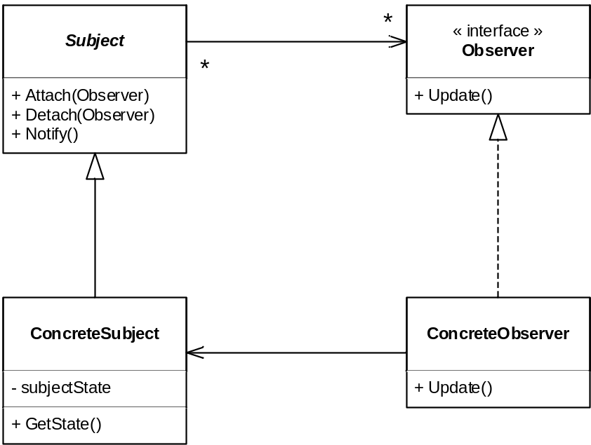
GoF Observer
Subject is an abstract base class for all subjects (i.e. things that get updated)
Observer is an interface that is implemented by all Observers, i.e. objects that wish to be informed of data changes
ConcreteSubject inherits from Subject. This is the actual class that must be monitored (in our case, Provider)
ConcreteObserver implements the Observer interface. This is the actual class that must receive updates (in our case, Consumer)

Slide 11
GoF Observer (w/o animations)
Subject is an abstract base class for all subjects (i.e. things that get updated)
Observer is an interface that is implemented by all Observers, i.e. objects that wish to be informed of data changes
ConcreteSubject inherits from Subject. This is the actual class that must be monitored (in our case, Provider)
ConcreteObserver implements the Observer interface. This is the actual class that must receive updates (in our case, Consumer)

Slide 12
Example: Blood Pressure Measurement
Description:
A system to measure and display blood pressure
Measurement:
  Set systolic BP
  Set diastolic BP
  Set ”measurement complete”
Display:
  When measurement complete: Display systolic and diastolic BPs
Sys: 128
Systolic BP: 128
Diastolic BP: 79
Dia:79
*DONE*
Measurement
Display

Slide 13
Example: Blood Pressure Measurement
Your task: Design this system using GoF Observer.
Think about:
  What is the Subject? Who is the Observer?
  What methods/properties do you need in the Measurement class?
  What methods/properties do you need in the Display class?
  Sketch the class and sequence diagrams for your design
Systolic BP: 128
Diastolic BP: 79
Measurement
Display

Slide 14
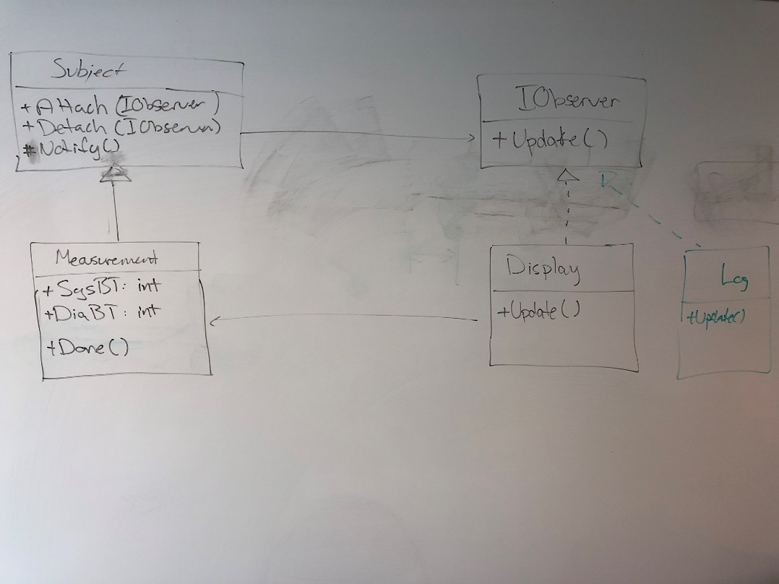
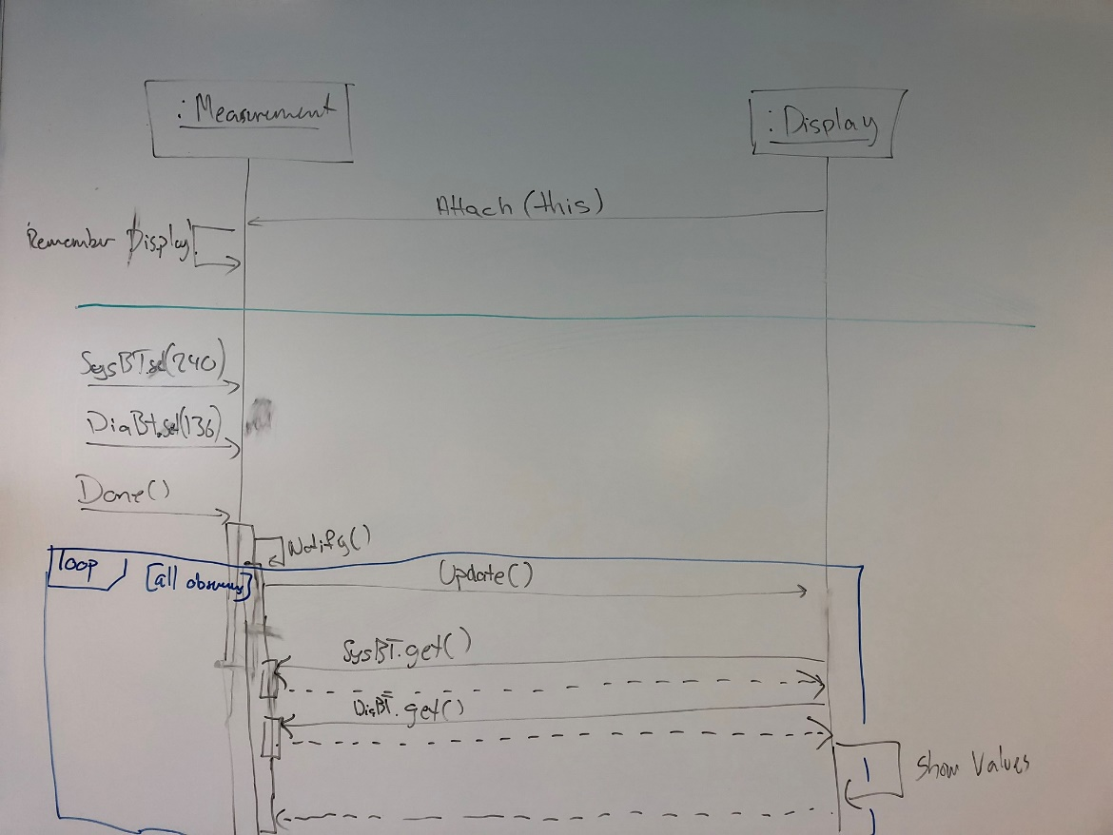
Design: Blood Pressure Measurement
Structure
Behaviour

Slide 15
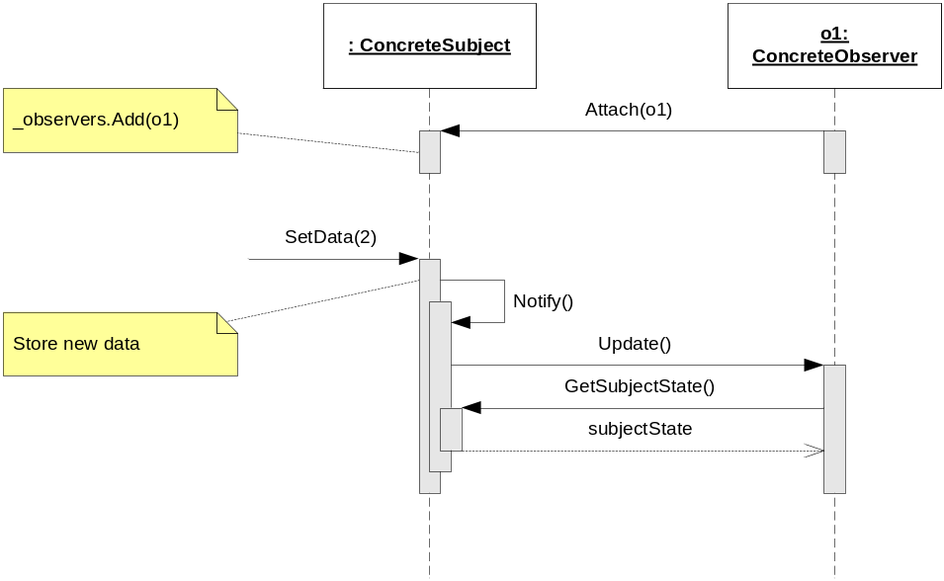
GoF Observer – pull and push variants
Pull variant
(Observer pulls state from subject)
This is the method used in our examples and exercises, but not in HFDP

Slide 16
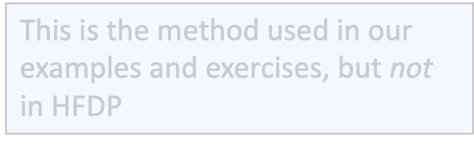
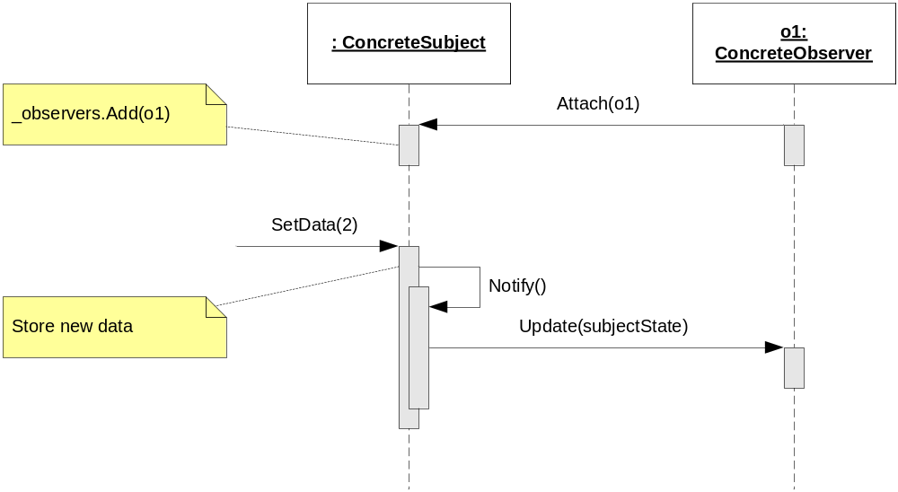
GoF Observer – pull and push variants
Pull variant
(Observer pulls state from subject)
Push variant
(Subject pushes state to observer)
This is the method used in HFDP, but not in our examples and exercises

Slide 17
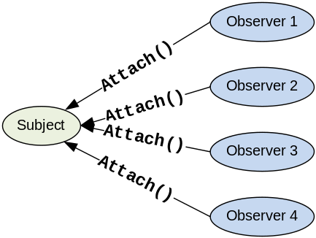

GoF Observer – more variants
Does GoF Observer handle that several observers attaches to the same subject?

Slide 18
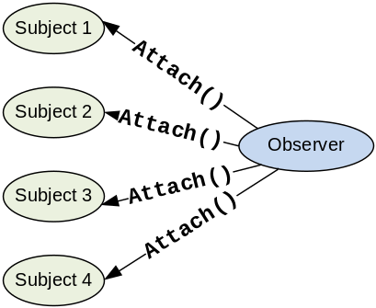

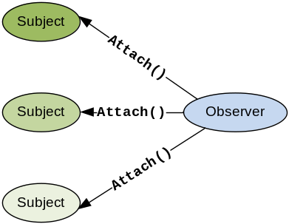
GoF Observer – more variants
Does GoF Observer handle that several observers attaches to the same subject?
Does it handle that an observer attaches to several subjects of the same type?
These topics are covered in SW4SWD,
on 4th semester!
Does it handle that an observer attaches to several subjects of different types?

Slide 19
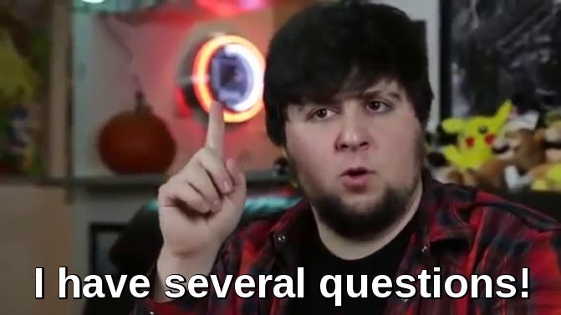
Questions?

